Slide 1
Environmental Ethics
Name
Institution
Date

Slide 2
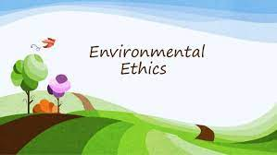
Introduction
Studies how people and the environment relate
Holds that people, animals, and plants are components of society
Animals and plants are considered because they are important to human life
Therefore, human beings should apply morals and ethics when dealing with plants and animals (Singh et al., 2019)
Notes:
Environmental ethics is a component of ethics, which focuses on how human beings relate to the environment and the role of ethics in this relationship. Environmental ethics hold that people, animals, and plants are components of society since animals and plants are important to human life (Singh et al., 2019). Therefore, human beings should apply morals and ethics when dealing with animals and plants. Environmental ethics complement scientific knowledge by adding human values, better decision-making, and moral principles into the discussion.

Slide 3
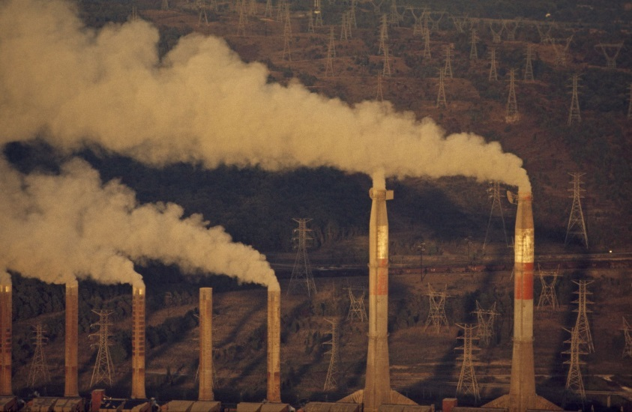
Ethical Dilemma
Global warming
Specifically, environmental pollution by business enterprises
Business enterprises release harmful chemicals and gases into the environment.
This pollutes water and the land and increases global warming
Consequently, human beings face adverse health impacts (Inyinbor Adejumoke et al., 2018)
Notes:
One of the ethical dilemmas related to environmental ethics is global warming and, specifically, environmental pollution by business enterprises. Industrial businesses emit harmful gases and chemicals into the environment. This pollutes water and land and thus increases global warming. Consequently, this affects not only human beings but also plants and animals. Notably, polluted seawater threatens the existence of marine animals and plants. Water, air, and land pollution result in adverse health effects on human beings, including asthma and cancer (Inyinbor Adejumoke et al., 2018). Global warming also increases the risk of drought as well as floods and threatens biodiversity, all of which have adverse impacts on human life, plants, and animals.

Slide 4

Recommendations
Use alternatives
Practice material reuse and recycling
Rethink the process
Consider renewable sources of energy (Tong & Ebi, 2019)
Notes:
In order to prevent global warming associated with air, water, and land pollution, business enterprises should consider using alternate materials. Notably, businesses should consider alternate materials like cleaners or lubricants in order to minimize the generation of waste, emission of gas, and health risks to humans. However, businesses should first make sure that such materials do not add toxic waste. Also, businesses should practice reusing and recycling as much as possible. Conversely, businesses should practice distilling solvents that have been used, swapping cleaning agents, and reusing clean cardboard boxes to minimize water contamination and land pollution. In addition, businesses should rethink stopping pollution from arising in the early stages. If such processes have to be done, they should consider if they can be done efficiently and less frequently. For example, businesses can consider if cleaning of parts can take place before the use of solvents, adjustment of machinery for efficient use of materials, or if cleaning frequency can be minimized. Besides, businesses should consider using renewable sources of energy like solar instead of diesel or petrol-powered machines, which are associated with high emissions of carbon dioxide into the environment (Tong & Ebi, 2019).

Slide 5
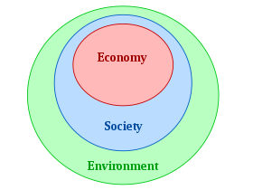
Ethical Concept
The moral principle of sustainability
Holds that the rate of the contamination and loss of water caused by human activities should not surpass the ability of water sources to cleanse as well as replenish themselves.
Unsustainable loss and contamination of water are against the intrinsic value of water.
Humans have the moral responsibility to take care of creation (Verma, 2019).
Notes:
One of the ethical concepts related to the issue of global warming, and specifically water pollution, is the moral principle of sustainability. This principle holds that the rate of contamination and loss of water caused by human activities should not surpass the ability of water sources to cleanse as well as replenish themselves (Verma, 2019). When businesses emit chemicals into water sources, they make water sources unable to cleanse as well as replenish themselves. Also, unsustainable loss and contamination of water are against the intrinsic value of water. Humans have the moral principle of being responsible for the creation, and this implies that they should exercise due diligence in treating water, shunning actions that result in water contamination, and preserving and protecting water sources.

Slide 6
References
Inyinbor Adejumoke, A., Adebesin Babatunde, O., Oluyori Abimbola, P., Adelani Akande Tabitha, A., Dada Adewumi, O., & Oreofe Toyin, A. (2018). Water pollution: effects, prevention, and climatic impact. Water Challenges of an Urbanizing World, 33, 33-47.
Singh, S. K., Chen, J., Del Giudice, M., & El-Kassar, A. N. (2019). Environmental ethics, environmental performance, and competitive advantage: role of environmental training. Technological Forecasting and Social Change, 146, 203-211.
Tong, S., & Ebi, K. (2019). Preventing and mitigating health risks of climate change. Environmental Research, 174, 9-13.
Verma, A. K. (2019). Sustainable development and environmental ethics. International Journal on Environmental Sciences, 10(1), 1-5.

